Slide 1


ecs36b Fall 2022: Software Development & Object-Oriented Programming #02: Object-Oriented Paradigm (2/2)
Abstraction
Encapsulation
Polymorphism
Inheritance
Dr. S. Felix Wu
sfwu@ucdavis.edu

Slide 2
Two sides of OO*
Complexity of the Problem itself
Solving real problems!!
Better Software Development

Slide 3

Complexity of the Problem itself
Solving real problems!!
Better Software Development

Slide 4
Object-Oriented Paradigm
Object-oriented analysis and modeling
Object-oriented design
Object-oriented programming
Object-oriented languages/constructs

Slide 5
OO Principles
Data Abstraction
Polymorphism
Inheritance
Encapsulation

Slide 6
OO Programming in C++
Data Abstraction
Polymorphism
Inheritance
Encapsulation
class GPS{…}
latitude
longitude
https://github.com/sfelixwu/Person_and_Thing

Slide 7
GPS.h GPS.o
Separate Compilation
class GPS_DD
{
private:
double latitude;
double longitude;
public:
explicit GPS_DD();
explicit GPS_DD(double, double);
double getLatitude();
double getLongitude();
double distance(GPS_DD);
void dump();
};
GPS_DD Nitin;
Nitin.dump();

Slide 8
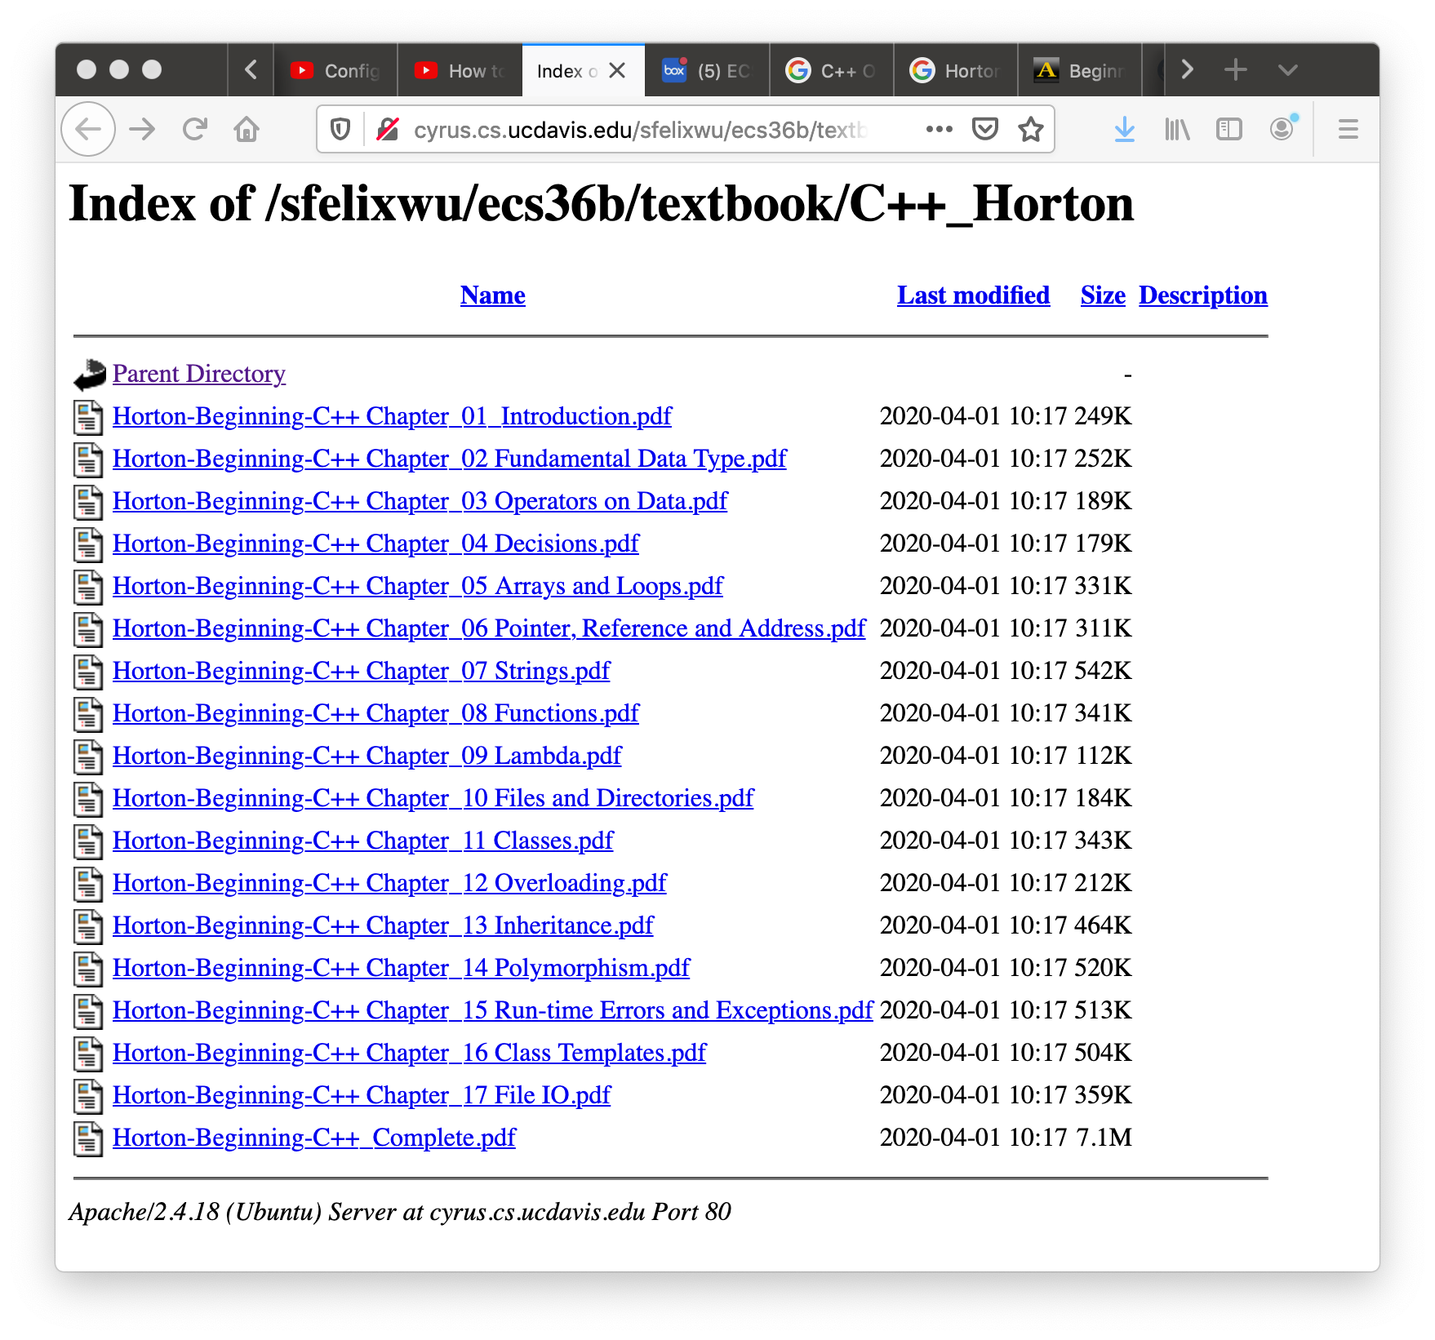

Slide 9
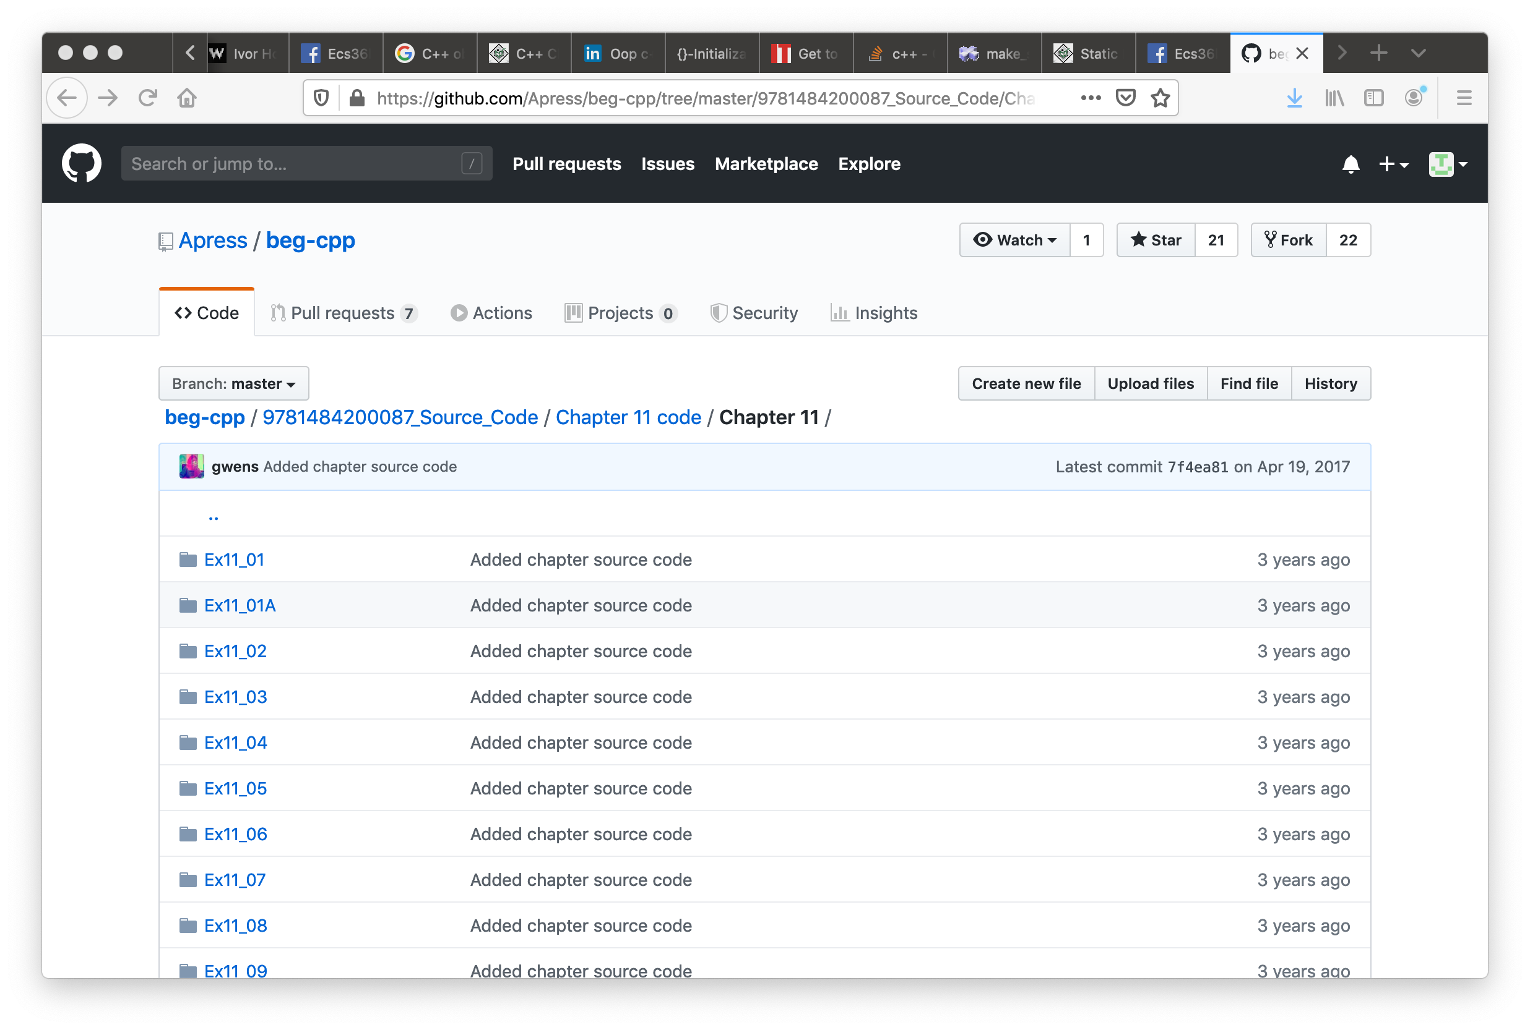

Slide 10
Objects/Classes
Data/attributes
Internal, external, inherited/protected
Methods (interface, member functions)
External, internal, inherited/protected, virtual

Slide 11
Objects/Classes
Data/attributes
Internal, external, inherited/protected
Methods (interface, member functions)
External, internal, inherited/protected, virtual
class class_name
{
private:
…
…
…
public:
…
…
…
};
latitude
longitude

Slide 12
Objects/Classes
Data/attributes
Internal, external, inherited/protected
Methods (interface, member functions)
External, internal, inherited/protected, virtual
class class_name
{
private:
…
…
…
public:
…
…
…
};

Slide 13
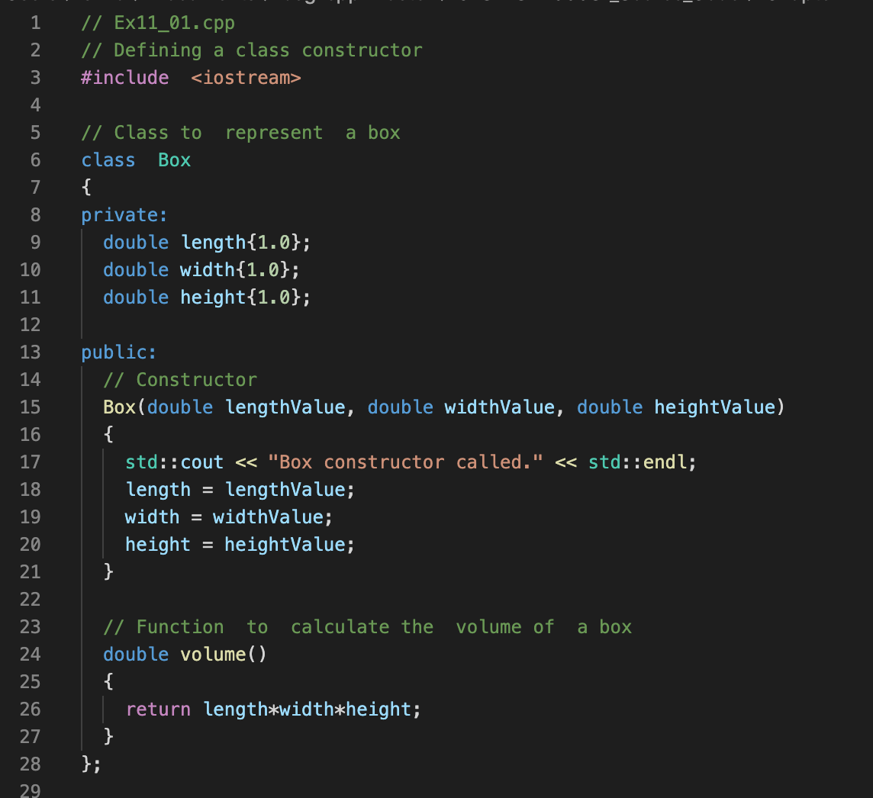

Slide 14
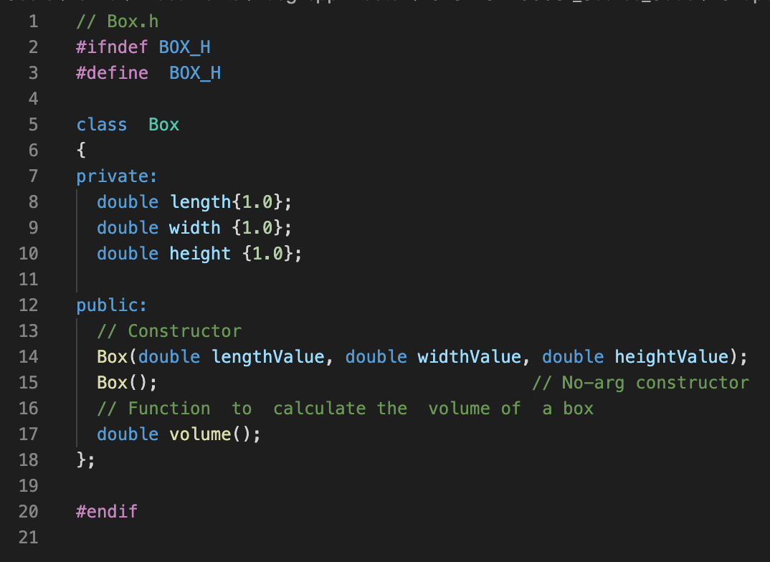

Slide 15
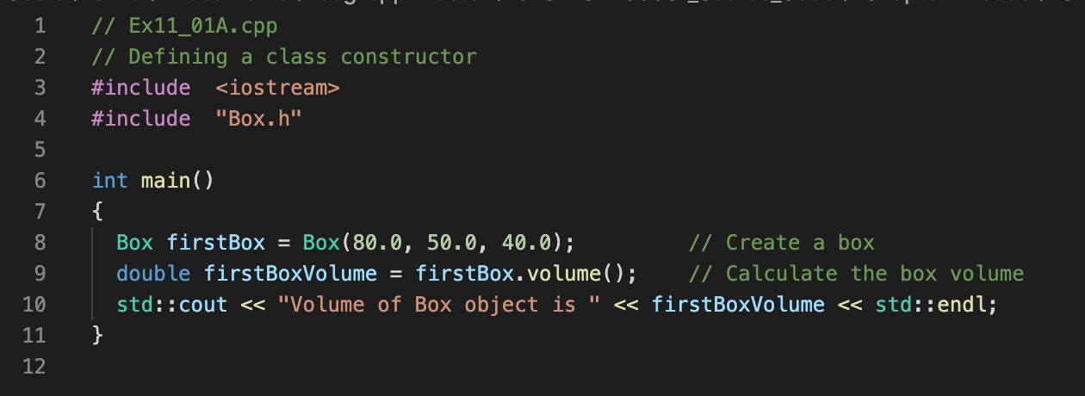
class Box;
C++ class, private and public
member functions
Constructors
V
length
width
height
C
C

Slide 16
class Box;
C++ class, private and public
member functions
Constructors
V
length
width
height
C
C

Slide 17
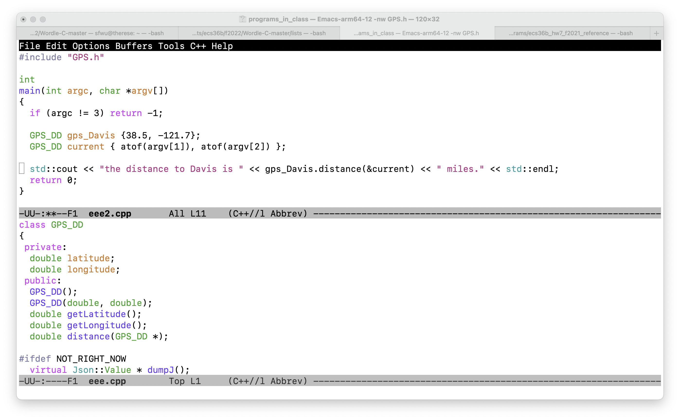

Slide 18
Function signature
Function name
Return data type
Input arguments and their data types.

Slide 19
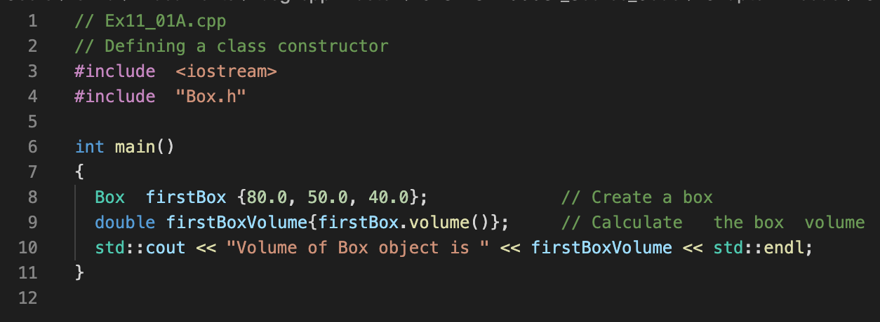
Felix’s version
Horton’s version

Slide 20
Felix’s version
Horton’s version

Slide 21
{ } Bracket Initialization
Available only after C++11
C++98 C++03 C++11 C++14 C++17 C++2a
g++ -std=c++2a Ex11_01A.cpp Box.cpp -o Ex11_01A

Slide 22
class Box;
C++ class, private and public
member functions
Constructors
Bracket Initialization
Namespace (Chapter 1, Horton)
V
length
width
height
C
C

Slide 23
Let us run some C++ programs!

Slide 24
double distance_calculated;
distance_calculated = gps_Davis.distance(current);
distance_calculated = gps_Davis.distance(GPS_DD {atof(argv[1]), atof(argv[2])});
distance_calculated = gps_Davis.distance({atof(argv[1]), atof(argv[2])});
distance_calculated = gps_Davis.distance({});

Slide 25
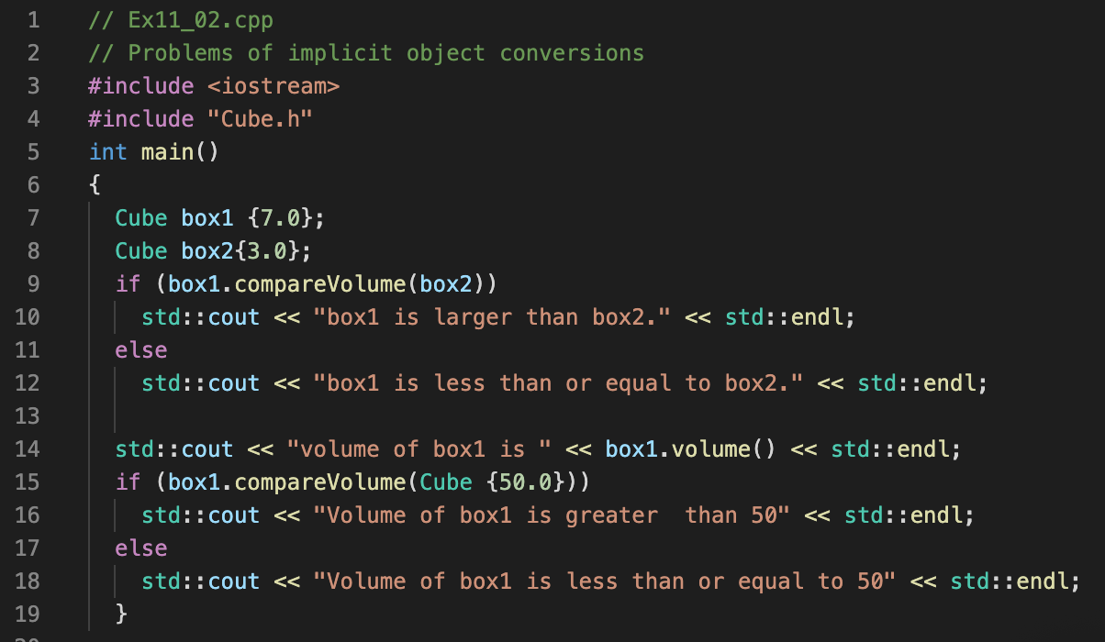
Good or bad?

Slide 26
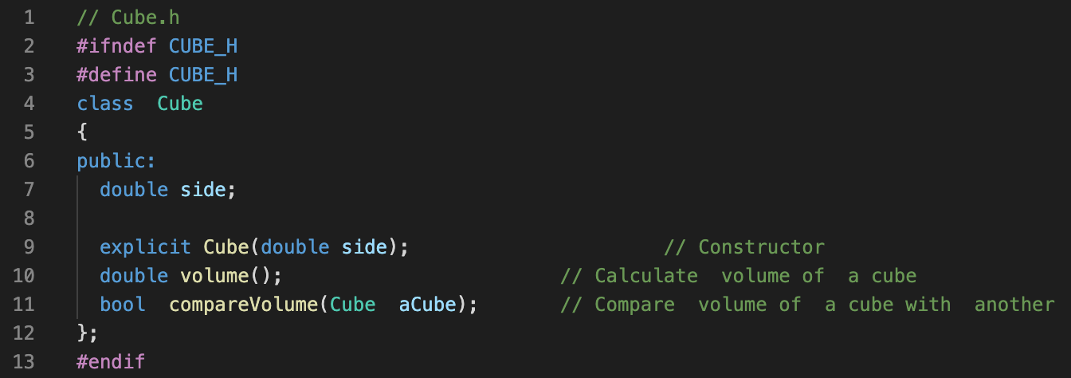
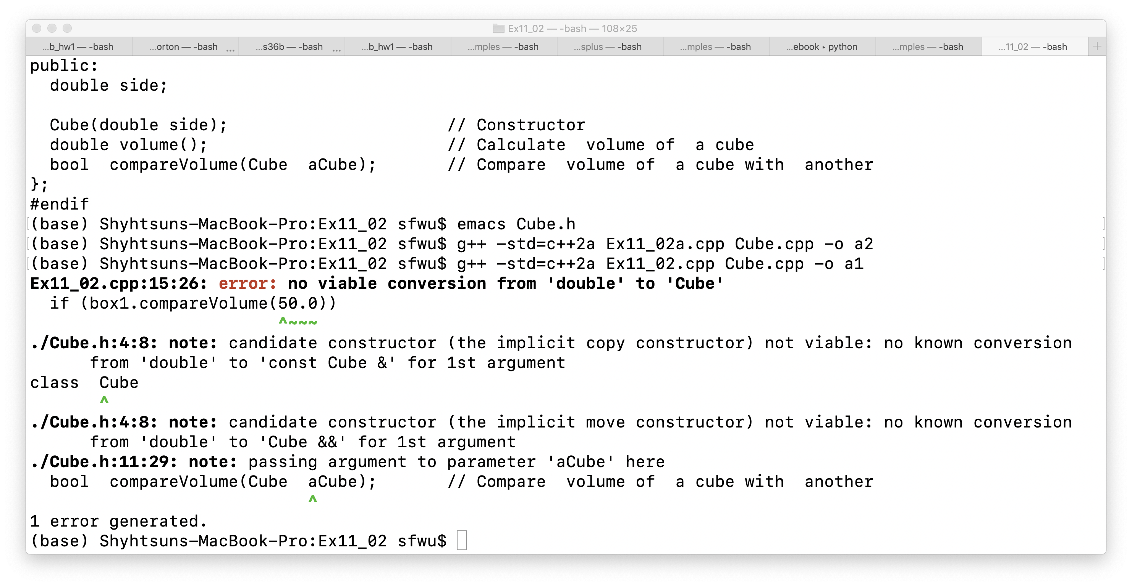

Slide 27
V
length
width
height
class
C
C
Can we track easily how many objects from this class have been created?
objects

Slide 28
V
length
width
height
Class Transaction
static variable
C
C
Can we track easily how many objects from this class have been created?
objects

Slide 29
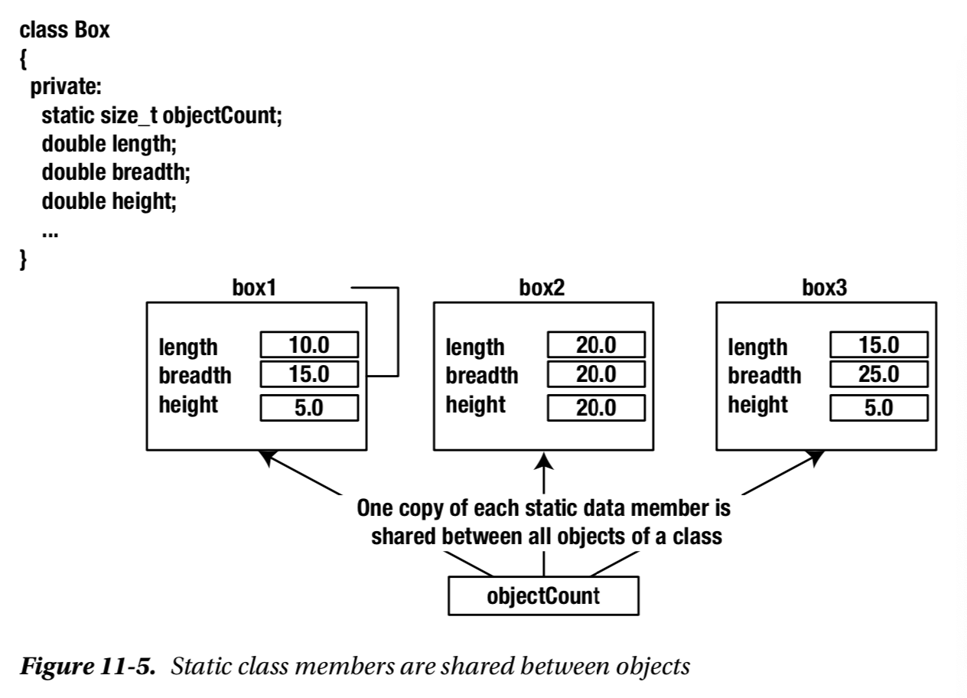

Slide 30
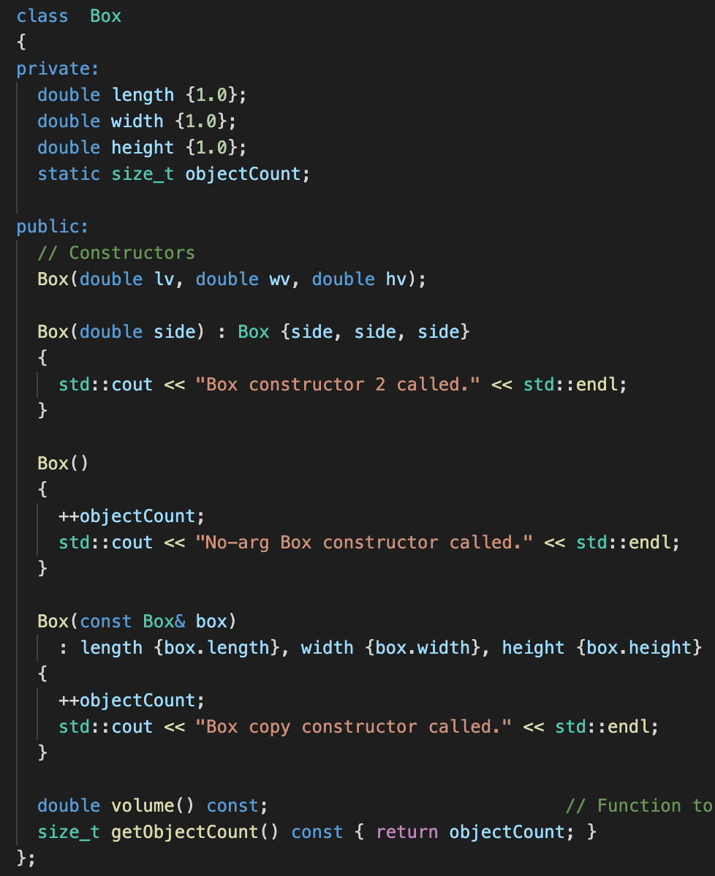

Slide 31
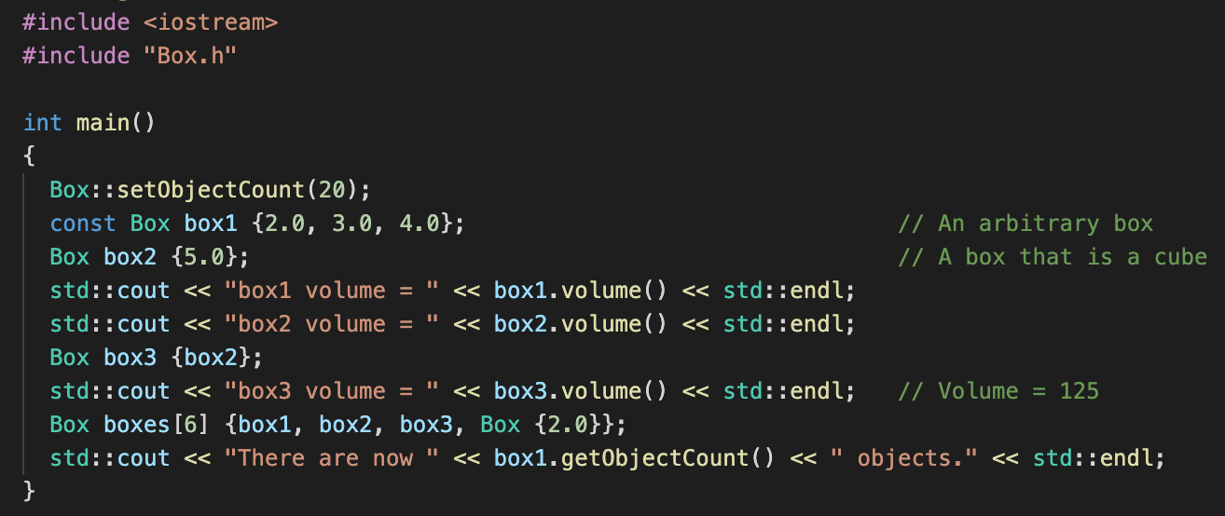
Accessing static variables before any object created

Slide 32
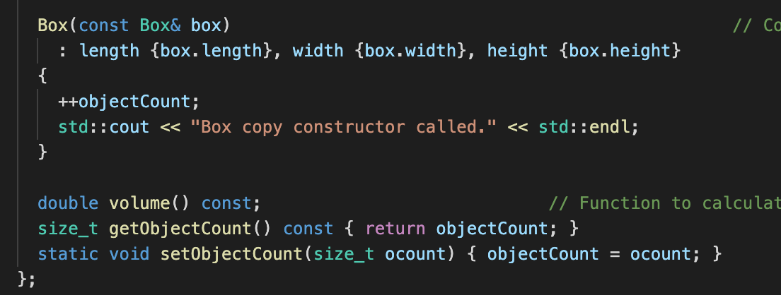
Box.h

Slide 33
#include "Transaction.h"
unsigned int Transaction::transaction_count { };
// unsigned int transaction_count = 0;
Transaction::Transaction(unsigned int arg_type)
{
Transaction::transaction_count++;
this->tr_type = arg_type;
}

Slide 34
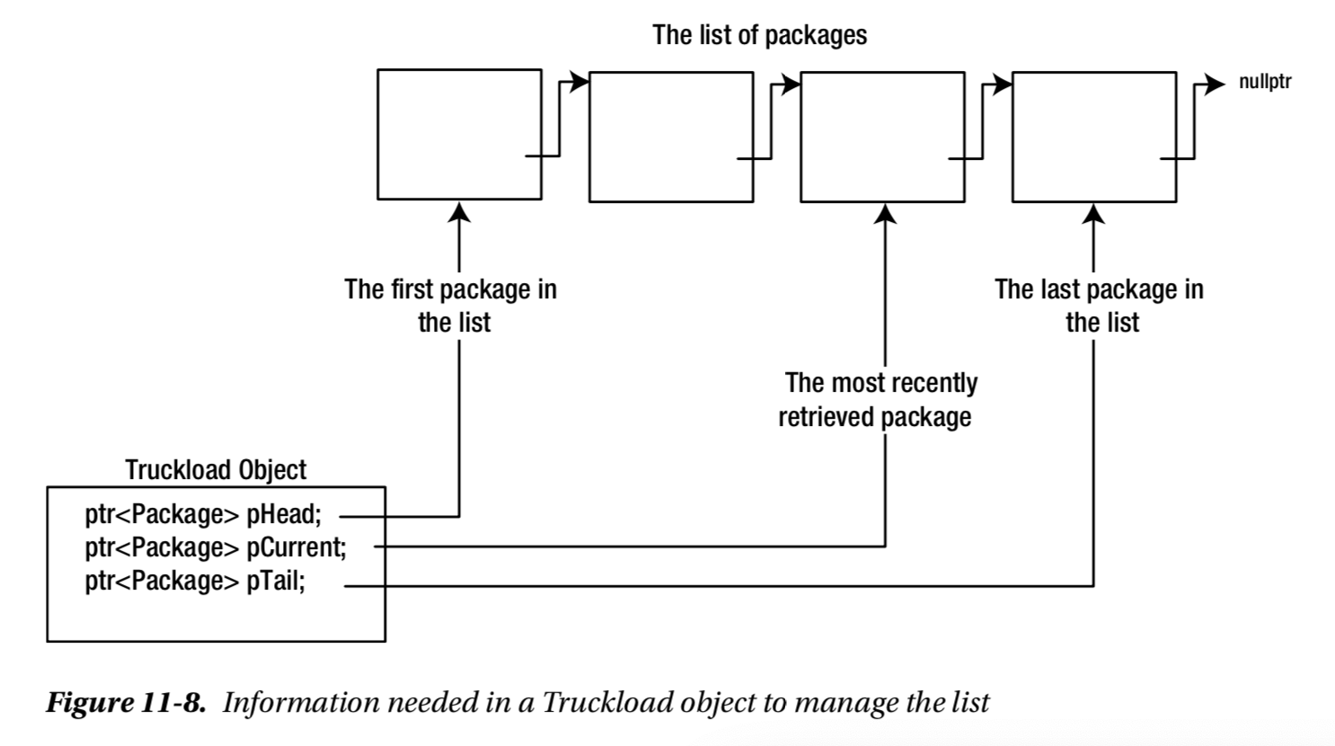

Slide 35
An Object
Integrity/Protection
Reusability
Abstraction

Slide 36
Two sides of OO*
Complexity of the Problem itself
Choosing the right-level of abstraction
Solving real problems!!
If you haven’t written the program, you don’t know what you are talking about!
Better Software Development

